Slide 1
Trauma Narrator Report Build
Erin Ward BSN, CEN, TCRN

Slide 2
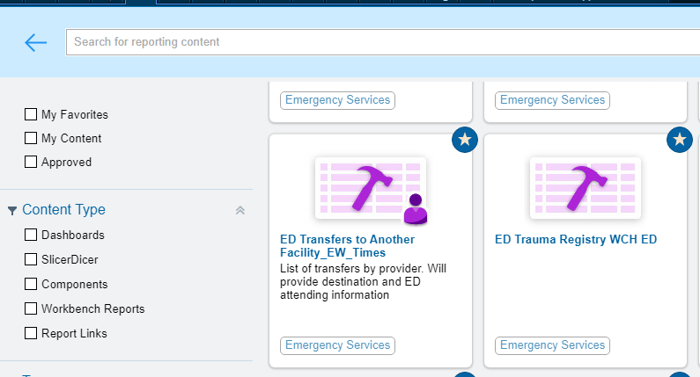
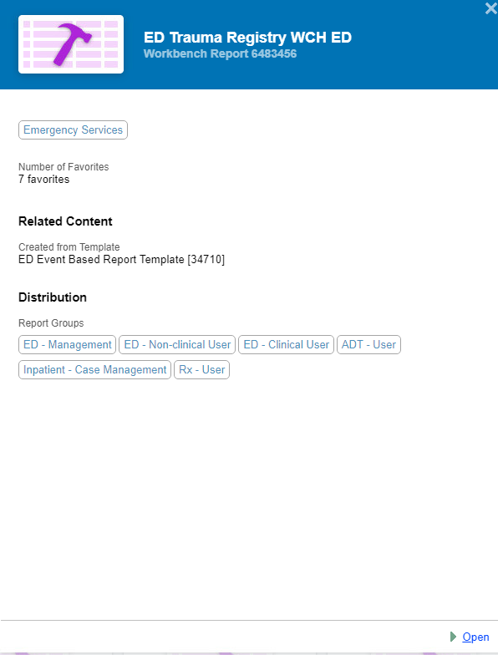
Modified existing EPIC (ED ASAP) report to create trauma specific report.

Slide 3
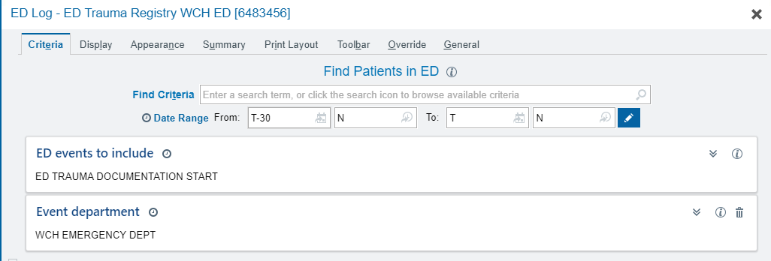
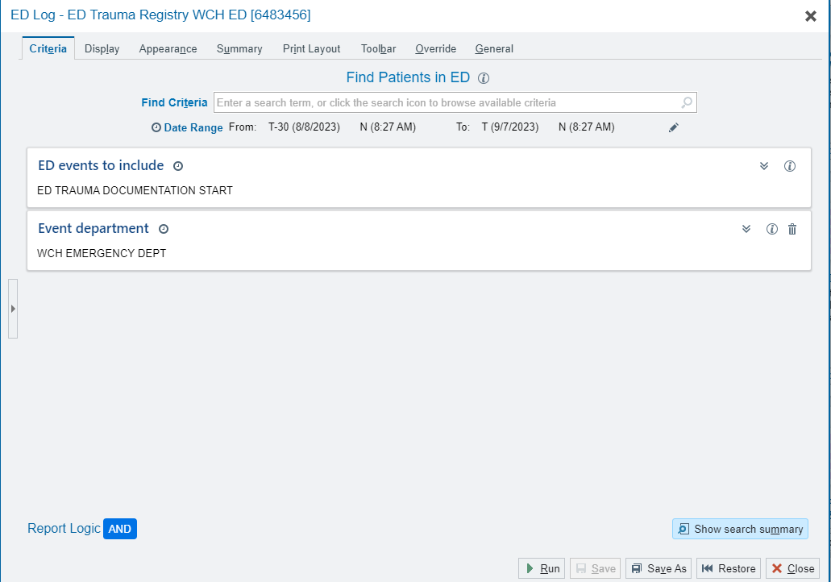
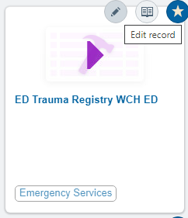
Choose the date range you want to evaluate.
Run report when you are ready.
Next slides show how to modify report.

Slide 4
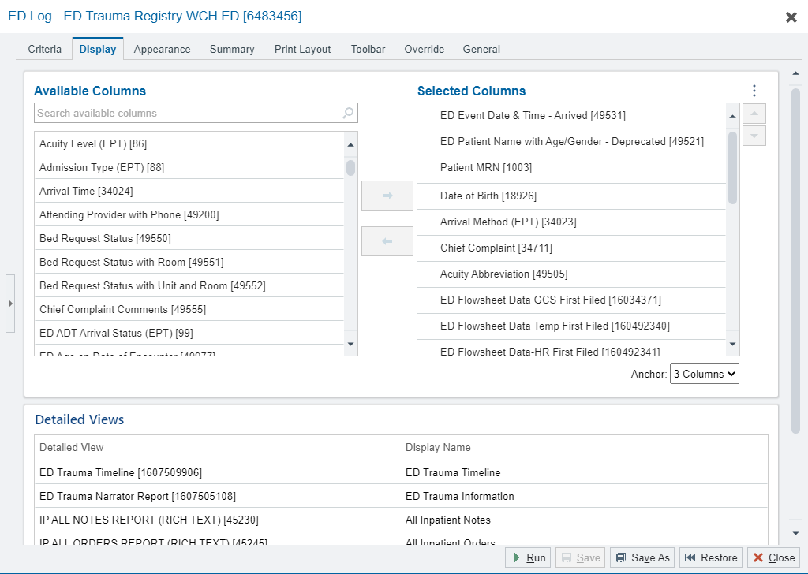
How to modify/edit the data in the report:

Slide 5
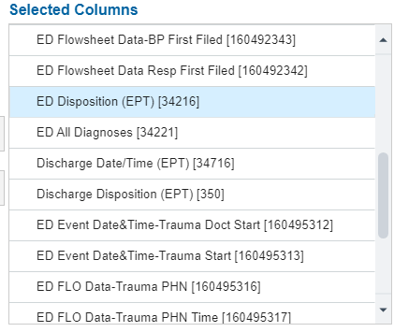
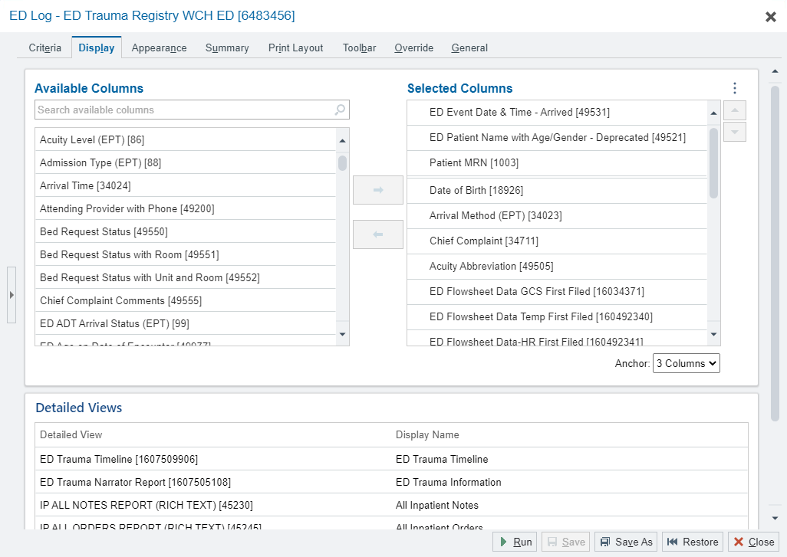
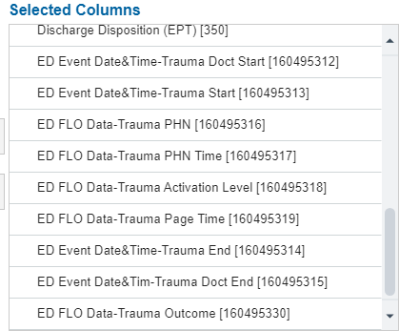
Any data point on the available column side can be added to the report (Selected column). It took lots of trial and error to determine which field were beneficial.

Slide 6
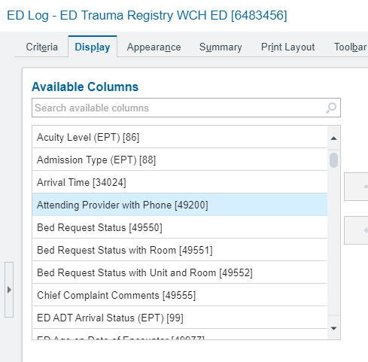
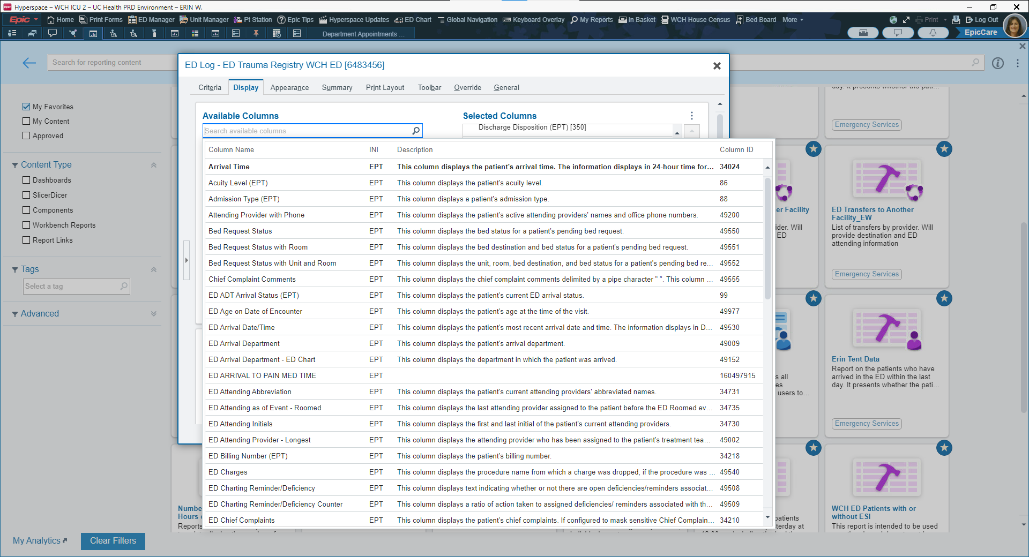
Click on the hour glass to see ALL available fields to add. You can search key words/phrases.

Slide 7
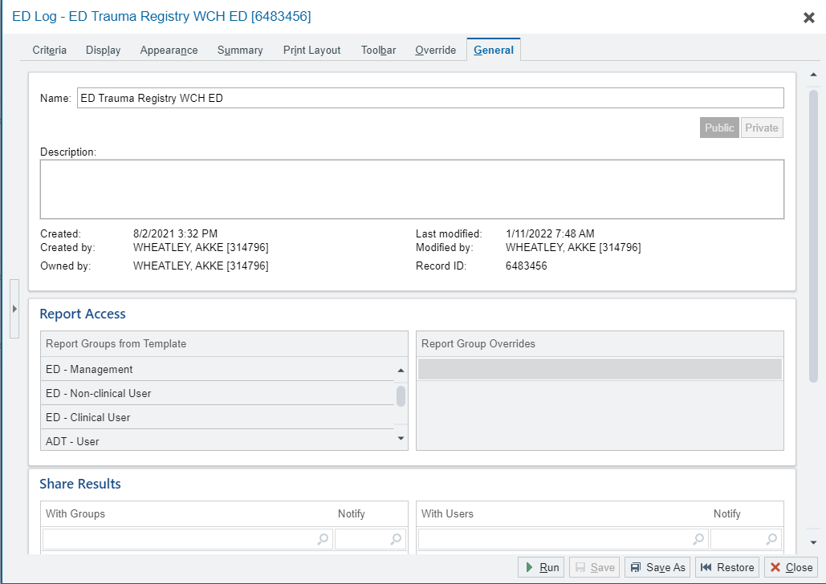
Once the report is made, you can share with others in your organization.

Slide 8
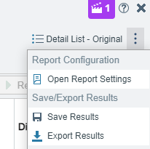
After the report is run, results display in EPIC
Results are exportable into excel.

Slide 9
Thoughts, tips, tricks:
Highly recommended starting with the EPIC experts.
Our initial report was created by the ED EPIC ASAP Analyst.
I updated report as needed to best suit evolving trauma PI needs.
Feel free to contact me with any questions. Happy to talk or meet on teams.
Erin Ward
Erin.Ward@UCHealth.com
UC Health West Chester Hospital Trauma PI Coordinator

