Slide 1
The New PRQ-
Gray Book Edition

Slide 2

Where to Find the PRQ:
Login to ACS site
Select Quality Programs.
Then select the ACS Quality Portal

Slide 3
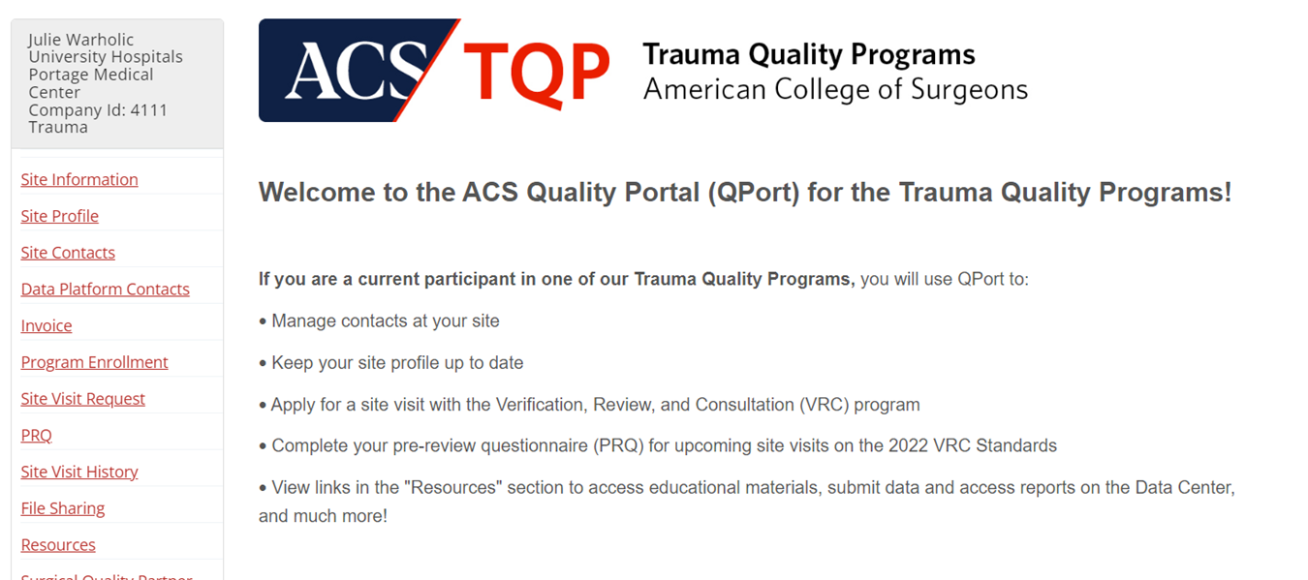
Where to Find the PRQ:
Choose PRQ on left

Slide 4
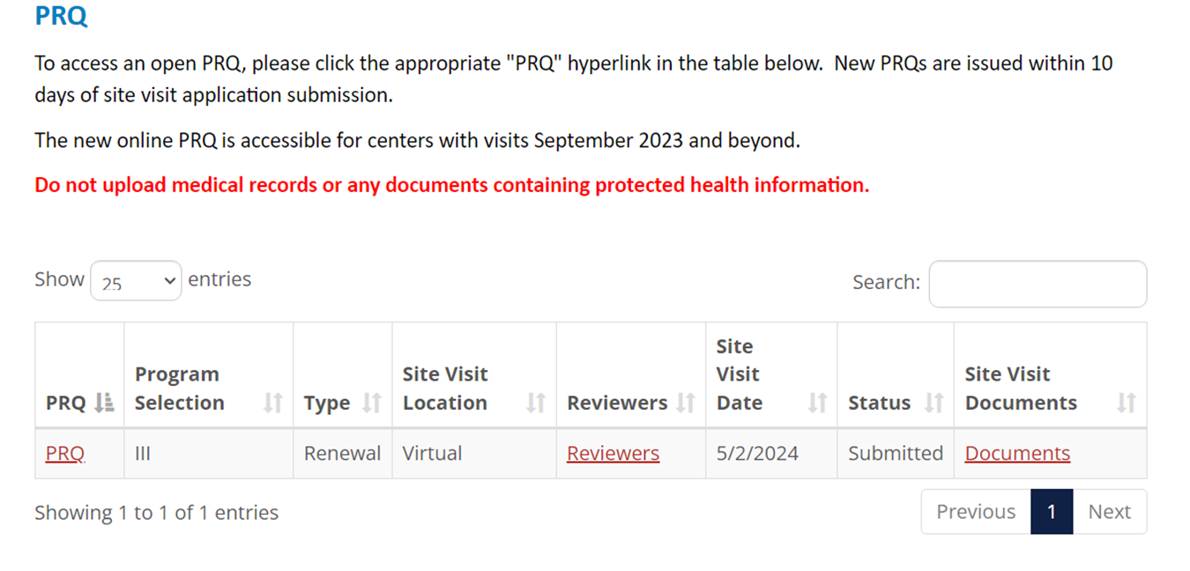
Where to Find the PRQ:
PRQ will launch your document to complete
Reviewers will show here and you may not get an email
Documents will be used to add additional documents after PRQ is submitted

Slide 5
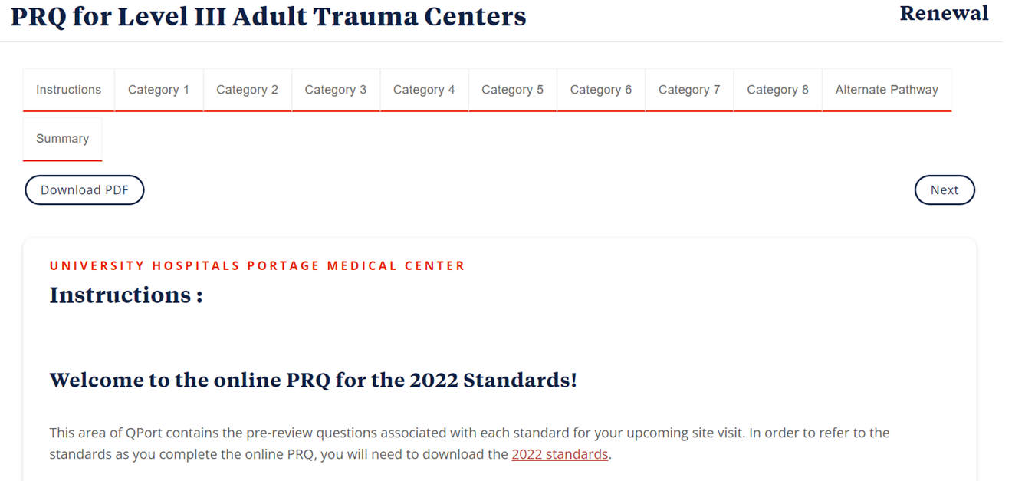
PRQ Layout
Each tab correlates with a chapter.
Summary will be where you list last survey corrections or OFIs.

Slide 6
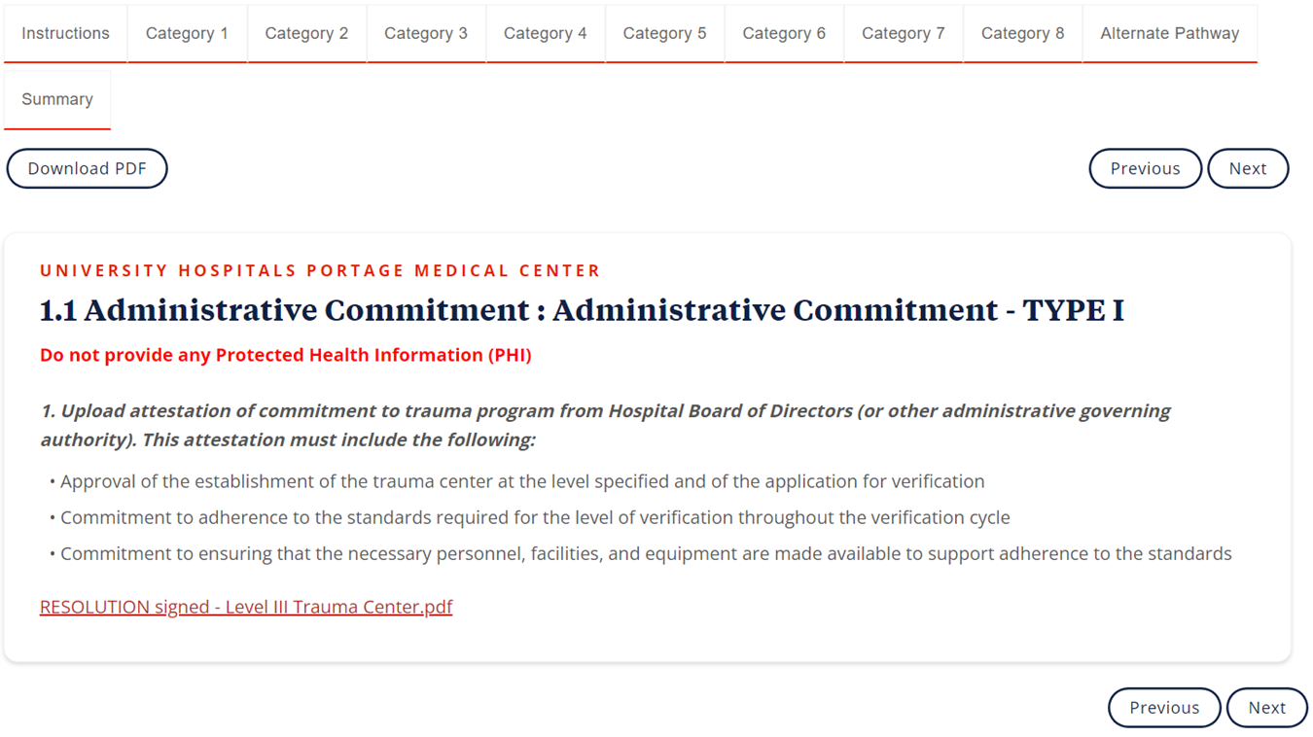
PRQ Layout
There will be an upload option on each standard for documents, if required.
*Sometimes these documents will auto fill later in the document*
You must upload documents when requested. If you don’t have a document, upload a blank document. The PRQ will not submit with empty fields.

Slide 7
START EARLY!
The New PRQ has new requirements that will take some time to collect.
Examples: ATLS certificate IDs, Board Certification Numbers, Credentialing letters etc.
Documents that accompany charts will be uploaded with the PRQ, so chart identification prior to PRQ submission will be beneficial in order to identify any edits that need to be made such as policy or guideline changes.
Minutes need to have PHI blocked out.
Will need to allow other departments time to gather information and respond. Give them their questions early!

Slide 8
START EARLY!
Combined Centers
Combined Adult and Pediatric centers will need to complete 2 separate PRQs
ETOH screening and intervention for pediatrics is age 12-14. The N is very small and will drastically skew the data when separated from the population 15 and up.
If no pediatrics trigger an intervention- the data can only be reported as:
  0%- which would flag as a standard not met
  100%- which is technically not accurate

Slide 9
Call Schedules (2.8)
Call schedules for entire reporting period are being requested, not just the last 3 months.

Slide 10
Standards are Very Specific.
For example (2.8), If the standard says the TMD needs 36 hours, but the TMD has only been there for a year. There is no prorating. The TMD will need all 36 hours.
(2.10) TPM CE requirements, same as above but will need 24 hours.
( 4.32)There must be a registrar with CAISS, regardless of hire date.

Slide 11
Response Times
There are quite a few standards that are asking for specific time responses. Time stamps of notification and arrival are required for trauma and specialty providers.
Radiology (4.14); 30 minutes of request.
Operative Team including Anesthesia (4.13); 15-30 minutes of request depending on level.
IR (4.15); 60 minutes of request.

Slide 12
Orthopaedic Response (5.21)
Table (NOT provided) will need to be completed with events of orthopaedic surgeon response. *This is not clear in the gray book as a measure of compliance*
30 minute time is recorded from time of request to time of arrival.

Slide 13
Neurosurgeon Response (5.17)
30 minute time is recorded from time of request to time of arrival/interpretation.

Slide 14
Templates Provided
(or Not)
There are several standards with templates that need to be completed (board certification, ATLS IDs, residency dates etc.)
The PRQ does not have a transfer template without transfer reason specified any longer. This has to be created with transfer reason categories determined by your facility. * This is not clear in the gray book *
FYI- There are fewer tables to complete than Orange book PRQ in terms of registry cohorts.

Slide 15
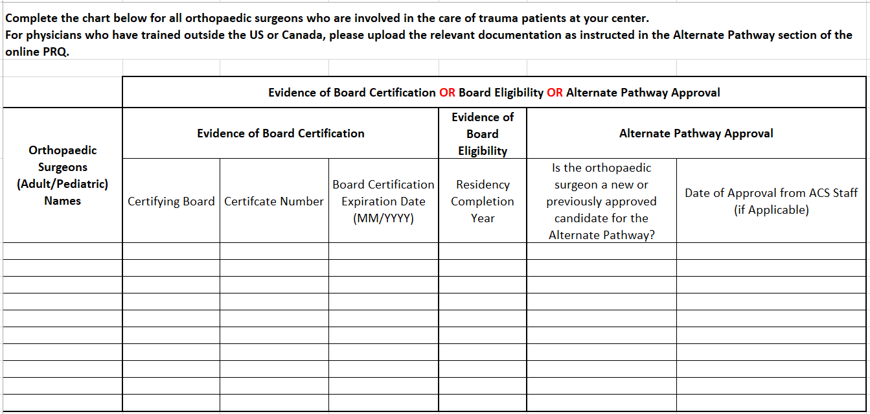
Templates Provided
(or Not)
*FYI*
AOBOS does issue certificate numbers.
ABOS does NOT issue certificate numbers.

Slide 16
Guidelines
(5.1)
Need a list of all guidelines with date of last revision. *This is not clear in the gray book*

Slide 17
Pediatric Readiness (5.10)
Ensure there has been a pediatric readiness assessment completed during the verification cycle.
Address any standards for which credit was not received, and the plan to correct or address these standards.

Slide 18
Diversion
(5.15, 5.16 & 7.9)
List every diversion incident including, reason, time start and time stop.
Be sure to document discussion of the diversion in your committee minutes!

Slide 19
PIPS (7.3)
Provide three initiatives that showcase the effectiveness of your center’s PI program * Not clear in the gray book as a measure of compliance*
Describe clinical practice guidelines that the center has developed over the last 3 years in response to identified opportunities for improvement * Not clear in the gray book as a measure of compliance*

Slide 20
Benchmarking
Briefly describe opportunities for improvement and actions taken to improve patient care identified through benchmarking. * Not clear in gray book measures of compliance*
This will need to be presented during the survey. Time slotted on review agenda.

Slide 21
Public and Professional Education
Be prepared to describe your center’s most successful public and professional trauma education offerings and events. *This is not clear in the Gray book*
Be prepared to provide percentages of completed education for ED, PICU/ICU, and PACU. Template is provided with some courses already listed (TCAR, TNCC etc.), as well as room for additional courses to be added.

Slide 22
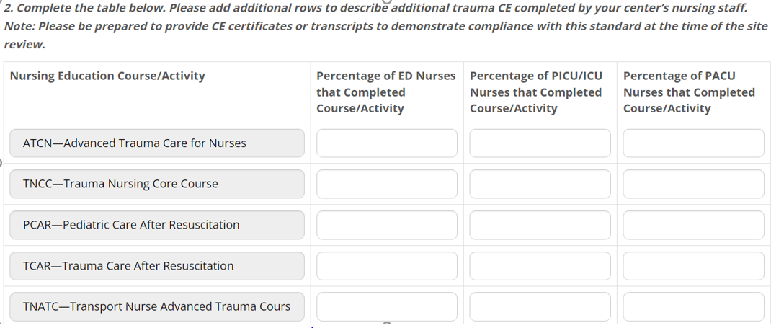
Public and Professional Education

Slide 23
Opportunities
Be prepared to address all opportunities for improvement from previous survey as last page of PRQ (Summary Tab). This will also be presented in the opening presentation at the start of the survey.

Slide 24
Sharing PRQ with Team
The PRQ is NOT printer friendly!
Best to complete the Word PRQ template and print to share with the team with questions, standard, context, and answers provided.

Slide 25
Helpful Tips
Print the PRQ and create a binder. Tab each standard. Remove the tab when standard is complete. This reduces revisiting standards you already finished.
Use empty space below standard to track your progress. For example, who you emailed last and when…
Create gap analysis that outlines what items are still not completed and why.
JUST answer the questions. Do not offer more information than needed. Save that for the discussions with your surveyors!
Don’t hesitate to reach out to a center that has already been through it!

Slide 26
???
Any Questions?

